Slide 1
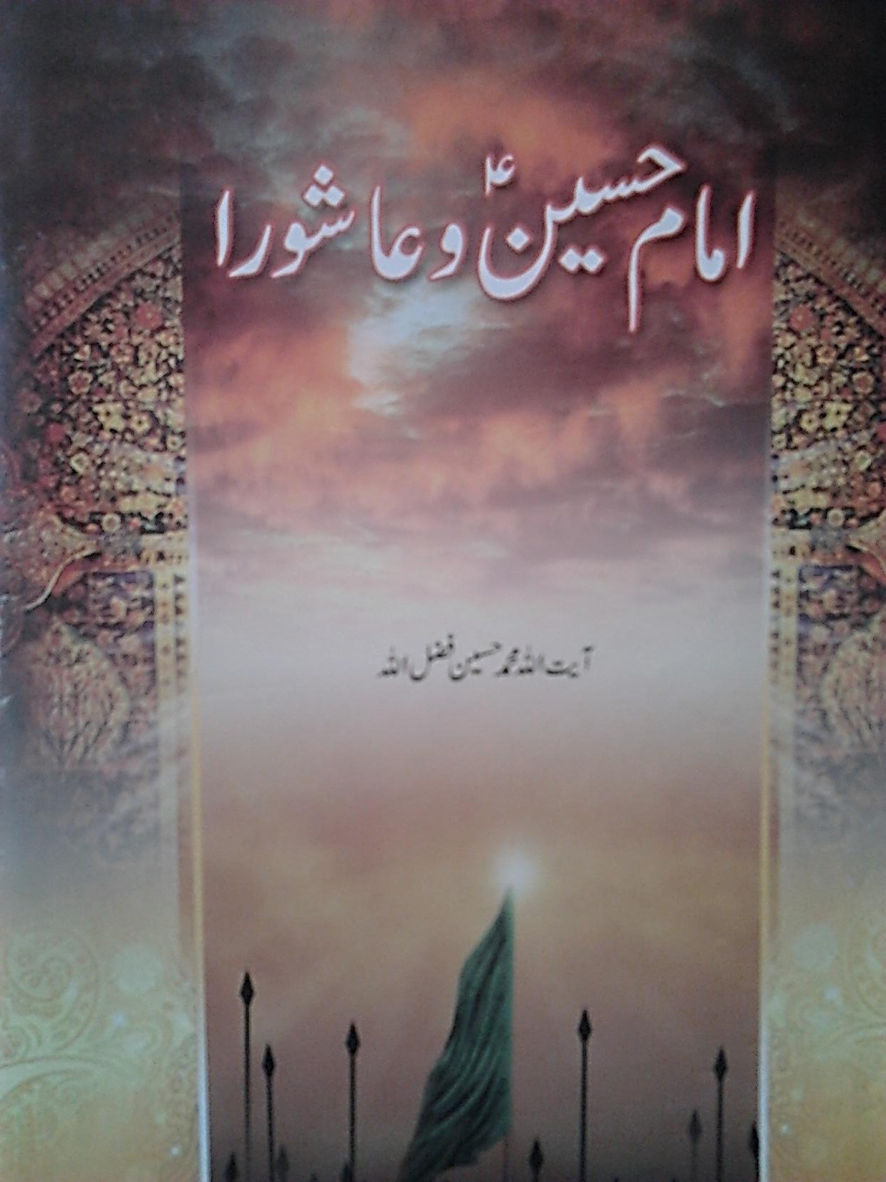
Imam Hussain a.s wa Aashoora

Slide 2
Information about Book
Name : Imam Hussain a.s. wa Aashoora
Author : Ayatullah M. Hussain Fazl ullah
Translator : Shaeed S. Saeed Haider Zaidi
Printer : Al Asr Publishers
Published : September 2014

Slide 3
Questions???
Kia Imam Hussain Ne Shahadat Ky Lia Qayam Kia Tha?
Imam Ky Makkay Se Nikalne Ki Wajah Hurmat e Kaaba Thi Ya Kuch Aur?
Intezar e Farj Kiun Kia Jaraha Hai?
Wo Kon Sa Wqt Tha Kay Jb Imam Ne Jang Ka Faisla Kia?
Aml e Islam Mein Is Wasi’ Peymaney Pr Imam Hussain Ki Shahdat Kay Ayyam Ka Maqsad Kia Hai?
Kia Aashora Hamarey Ander Koi Tabdeeli Laya Hai?
Kia Hum Karbala kay waqaye me Ghair Janib dar hen ya nhi?

Slide 4
Aashoor Ki Waqia Nigari Aur Riwayat Ka Haqiqi Jaeza
Riwayat:
Khuda mjhe qatl hote dekhna Chahta h, aur Aurto ko aseer hote…….
Jab kay Imam ne Farmaya:
“Jo koi Haram e Khuda ko Halal aur,Sunnat e Rasool kay br Khelaf ho….. Aur koi dosra apne guftar , Kirdar se us ki mukhalfat na kry to uska thikana is zalim kay sath hi hoga”

Slide 5
“ Jo koi mere haq ko radd krde to main sabr krnga, yahan tk kay Allah mere aur us kay darmian faisla na krde”
18000 Khat , Kufa se
Rone aur Rolane wali Zehniat:
Jazbati Kalam: “ Ae talwaron aao mjhe mardo”
Is taharn ki Riwayat Imam ko kamzoor aur lachar dekhati hen
Isi tarhan bibi Zainab s.a ki Shakhsiat b rone wali maloom hoti hai…….!

Slide 6
Hussaini Uswa e Amal Aur Millat e Islam Ki Zimmedari
Yazeed Ki Hukumat vs. Shahadat
“ Is Kameen Ibn Kameen Ne Mjhe Do Raaston Kay Darmain La Khara Kia Hai, Ya Talwar Utha Lun Ya Zillat Uthao’n , Baeed Hai Kay Me Zillat Qobol Kru’n.
Lebanon Aur Palestine

Slide 7
Islah Ki Himayat, Tehreef Ki Mukhalfat
Nadan Khatib Aur Shuara
Wo Ilfaz Mqbool Hojate Hn…..
“Agar Qaza Na Hoti To Ap Ki Talwaren Kaenat Ko Neest O Nabood Kr Deten”
Qadamat Pasandana Rasoom O Riwaj
Qama Zani: Ghair Muslim Ki Aara’a, Turk Ka Khayal
Ek Bache Per Tashadud
Aaqae Khuei Ne Farmaya:
“Agar Logo’n Ki Nigaho’n Main Mazhab Kay Tamaskhur Ka Baa’is Ho”

Slide 8
Qayam Hussain Ki Alif Bay
Hijrat aur Tarikh e Islam ka Aghaz
Do Hijratain
Qatl e Usman ka Fitna, Mawiya ne Aag Bharkai
Basra Me Jamal, Sham me SifFeen, Iraq me Khawarij
Makkah Main Tablighi Marhala
Bigaar Ki Islah Kay Lie Kalam,
“Khuda Ki Qasam Mere Pesh e Nazar Haq Ka Qayam Aur Batil Ka Mitana Na Ho, To Ye Beqimat Jota Mjhe Tumhare Uper Hukumat Krne Se Kahen Ziada Mehbob Hai”

Slide 9
Hussain Ibn Ali ki Tehreek
Imam Ki Chand Sifaat:
Aise Shaks Pe Zulm Krne Se Parhez Krna Jis Ka Khuda Kay Siwa Koi Madadgar Na Ho
Munafiq Na Hona, Q K Wo Kisi Ikhlaqi Usool Ka Paband Nhi Hota.
Bakhshish Wala Sir Buland Aur Bukheel Zaleel Hai
Amar Bil Ma’aroof O Nahi An il munkir

Slide 10
Inqelab aur Shahadat ka Pehlo
Qayam Rehbari Kay Liye Tha
Ye Rasta IKHTIYARI Tha
Imam Musalsal Muslim Society Ka Jaeza Le Rahe The
Ghum Se Na Umeedi Aur Kamzori Nhi Samajhni Chahiye
Aur Har Society Me Hamain Imam Hussain Kay Kirdar Ko Apnana Chahiye

Slide 11
Zikr e Hussain ka Ehtaram
Hum Apni Zindagi Me Wapis Aate Hen…. Tamam Ashk Fishani Bhool Jate Hen
Azadari Ishq E Wilayat Aur Mohabat E Ahl e Bait Ka Zariya Hai.
“Kisi Qoum Kay Amal Se Razi Ho Jane Wala B Usi Kay Sath Shumar Kia Jaega”
“Me Bartari, Fakhr Kay Lie Nhi Balke Amar Bil Maaroof K Liye Qayam Kr Raha Hn”

Slide 12
Imam Hussain Shaheed e Islam
Imam Hussain ka ta’alluq kisi khas zamane sa nhi hai
Puri history me Yazeed ek Shaks tha, aur abhi bhi wo soch mojod h
Sham, Iraq aur Lebanon kay Mujahido’n ki Tarhan hona Chahiye

Slide 13
Humari Zindagi Per Ashoor ka Asar
Mukhtalif Umoor Me Humara Tarz e Amal
“Aankhen Andhi Nhi Hoteen Balke Senoo Me Dil Andhe Hote Hen”
“Zalim Kay Dushman Rehna Aur Mazloom Kay Madadgar”
Bache Ko 7 Saal Azad Choro, 7 Saal Tarbiat Kro, 7 Saal Dost Bnao
Agahi Kay Sath Ashk Bahana Chahiye
“Logo’n Kay Dil Ap Kay Sath Hen Aur In Ki Talwarain Ap Kay Khelaf”

Slide 14
Imam Ki Apne Dosto’n Se Bey Loss Mohabbat
Bibi Ne Taziane Khae To Kia Wo Aj Bi Apne Ap Per Taziane Marteen?
Sham Aur Palestine Ki Aurtoon Ki Misal

Slide 15
Conclusion:
“Jab Hum Kisi Bemari Ka Ilaj Krte Hen To Mumkin Hai Kay Wo Takleef De Ho, Lekin Kch Muddat Baad Aaram Ajaga”

